Slide 1

PROF. V. B. SHAH INSTITUTE OF MANAGEMENT,
R. V. PATEL COLLEGE OF COMMERCE (ENG. MED.),
V. L. SHAH COLLEGE OF COMMERCE (GUJ. MED.) &
SUTEX BANK COLLEGE OF COMPUTER APPLICATION & SCIENCE
(Accredited ‘B’ (CGPA 2.55) by NAAC Dec.-2009)
VEER NARMAD SOUTH GUJARAT UNIVERSITY, SURAT
MINOR-PROJECT REPORT
BACHELOR OF COMPUTER APPLICATION
(5TH SEMESTER) YEAR 2025-26
AIRSTRO
GUIDED BY:
Ms. Sanskruti Ramani
SUBMITTED BY:
647 – NISHIL CHAVDA
658 – DEEP SORATHIYA
678 – RAHUL GADHIYA

Slide 2
OVERVIEW
Project Profile
Project Overview / Features
Diagrams
Future Enhancements
ScreenShots

Slide 3
PROJECT PROFILE
TITLE | AIRSTRO
FRONTEND | React.JS, Tailwind CSS
BACKEND | Node.JS, Express.JS
DATABASE | MongoDB
BROWSER | CHROME, FIREFOX, SAFARI
GUIDE BY | Ms. Sanskruti Ramani
SUBMITTED TO | Ms. Sanskruti Ramani

Slide 4
PROJECT OVERVIEW / FEATURES
Flight Search Functionality: Allows users to search for available flights based on their travel preferences.
Flight Booking Capability: Enables users to book flights directly through the platform.
User Registration and Authentication: Provides a system for users to register and log in, ensuring secure access to their booking information.
Admin Panel Access: Includes an administrative interface for managing flight schedules, user accounts, and bookings.
Responsive Web Interface: Features a user-friendly and responsive design, ensuring accessibility across various devices.
Backend Integration: Utilizes a server-side component to handle data processing, user management, and flight information retrieval.

Slide 5




PROJECT OVERVIEW / FEATURES
User Access Client Interface
Data Interaction
Content/
Functionality
Display
Admin
Management

Slide 6
PROJECT USE CASES
User Authentication : Enables user registration, login, and profile management.
Admin Dashboard : Provides administrative controls for managing users and content.
Car Management :Allows admins to add, update, and delete car listings.
Booking System : Facilitates car booking with date and time selection.
Location Integration : Incorporates location-based services for car availability

Slide 7
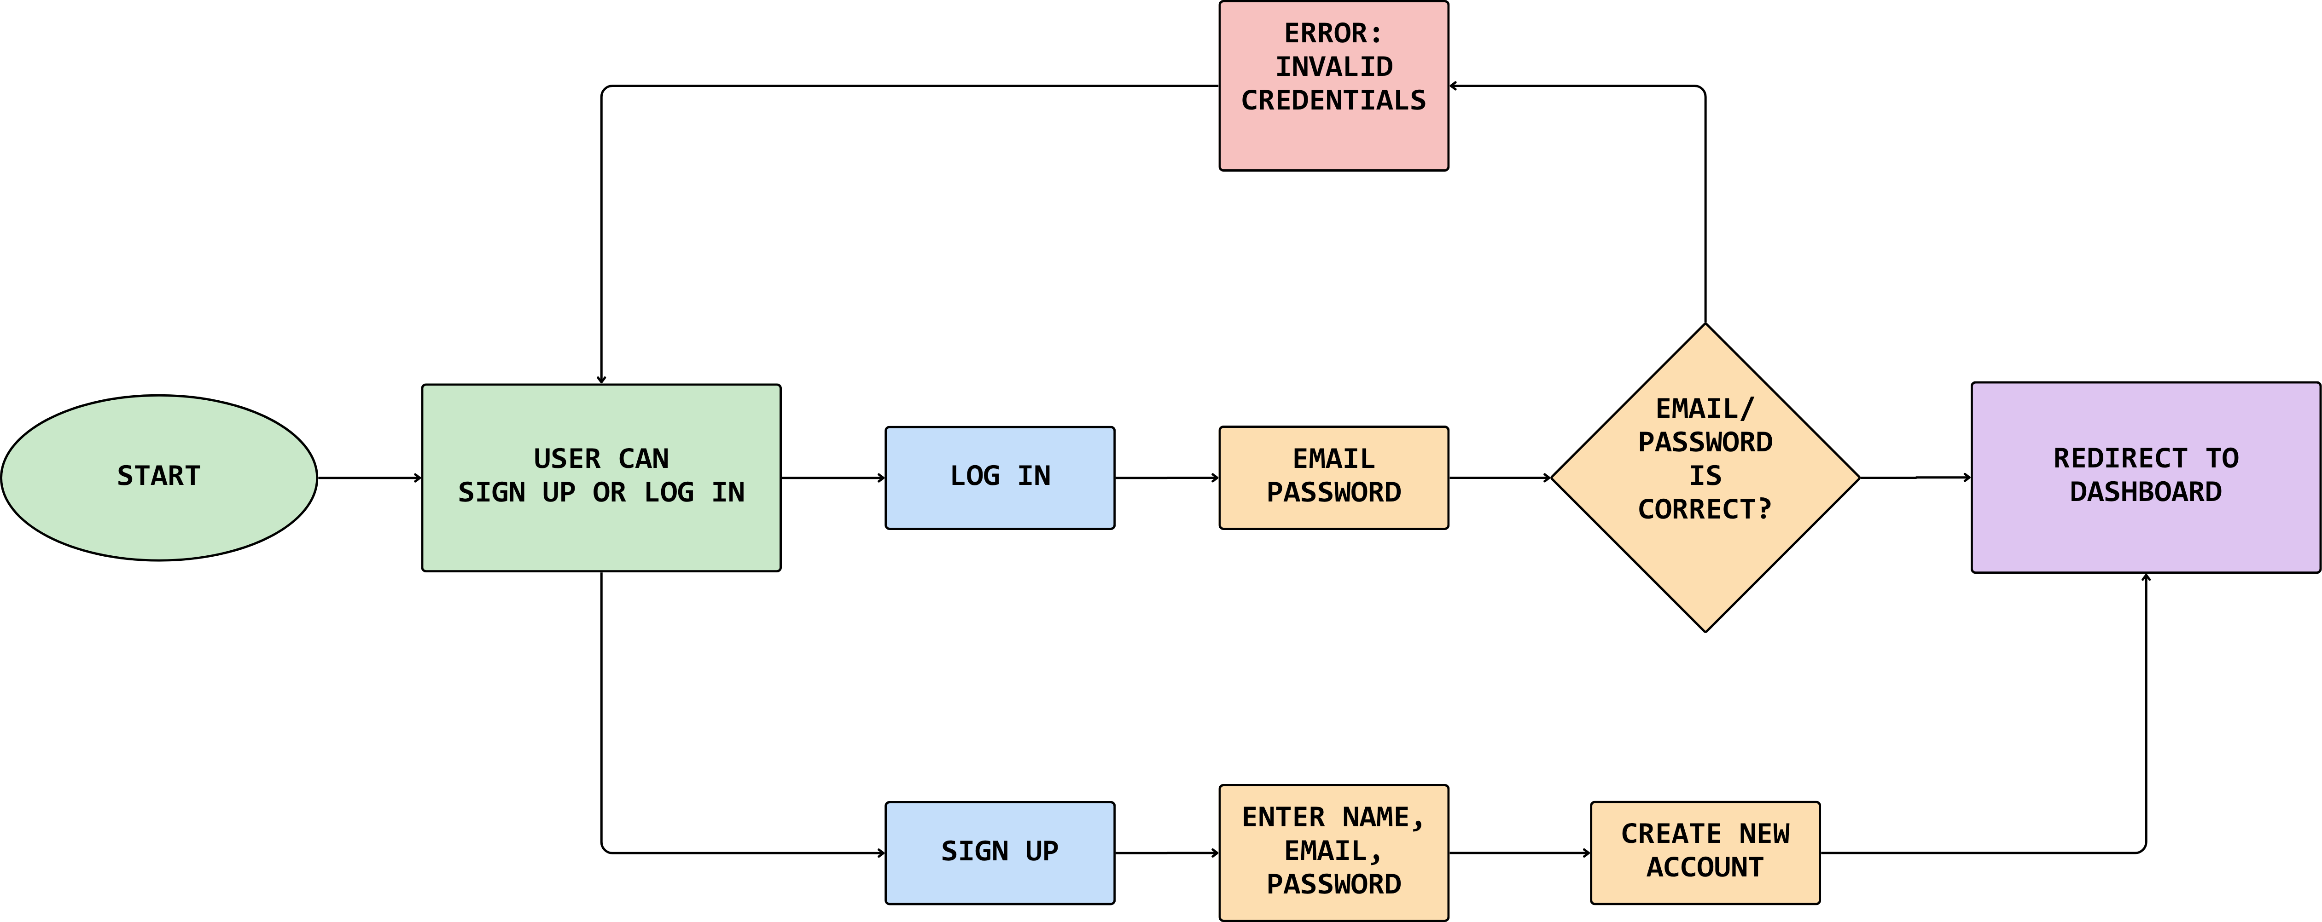
SIGN UP/LOG IN

Slide 8
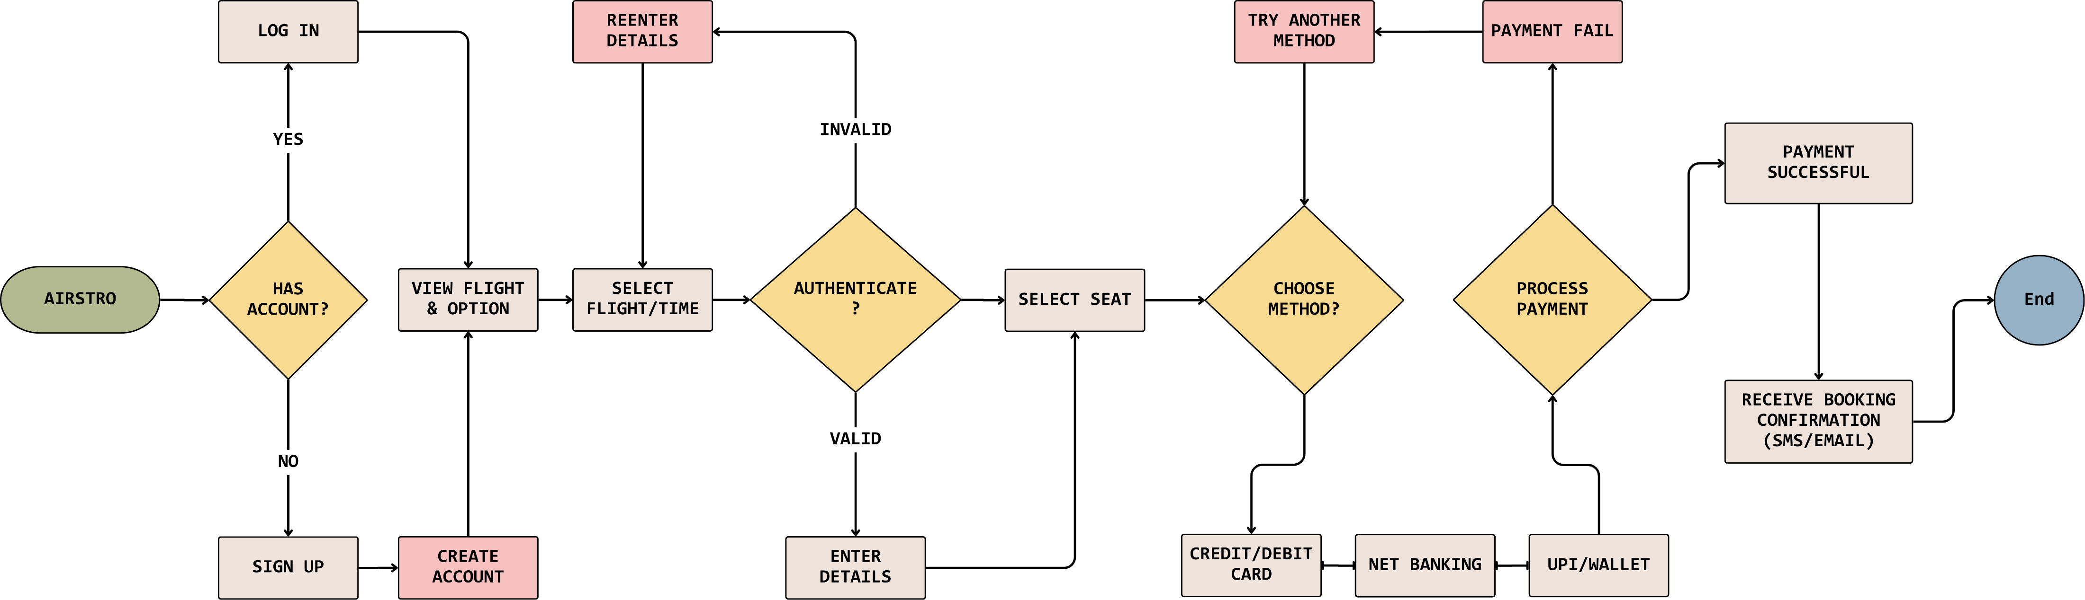
USER PROCESS FLOW DIAGRAM

Slide 9
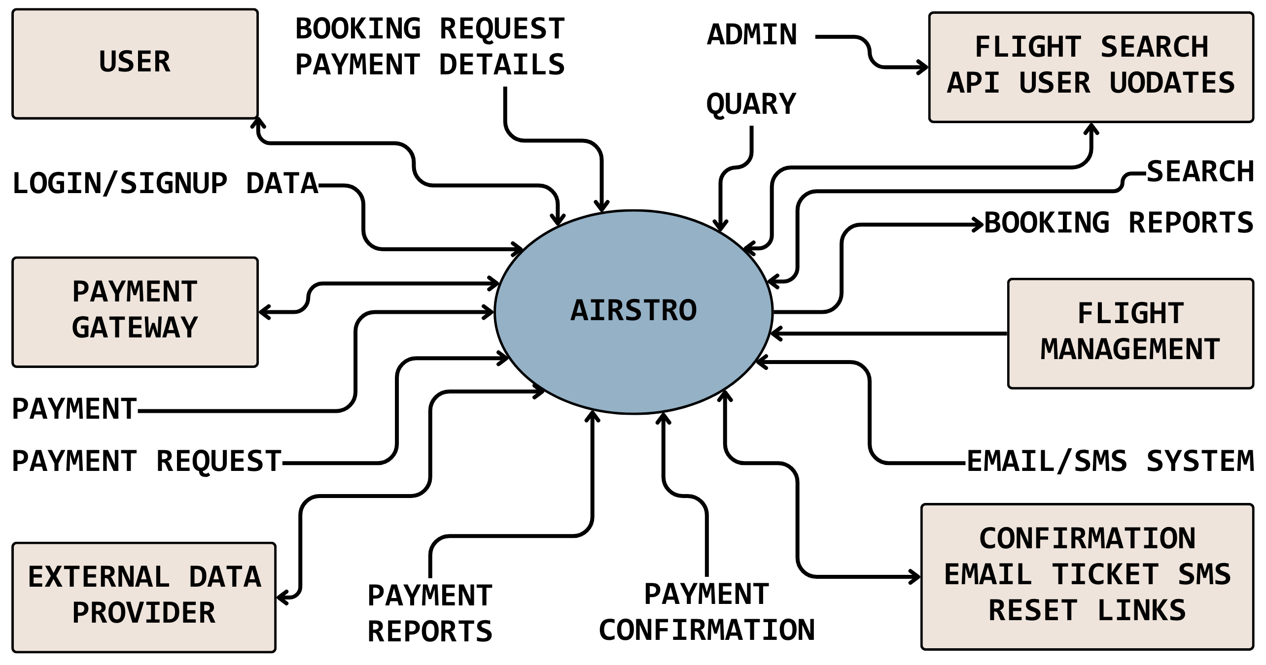
0 LEVEL DIAGRAM

Slide 10
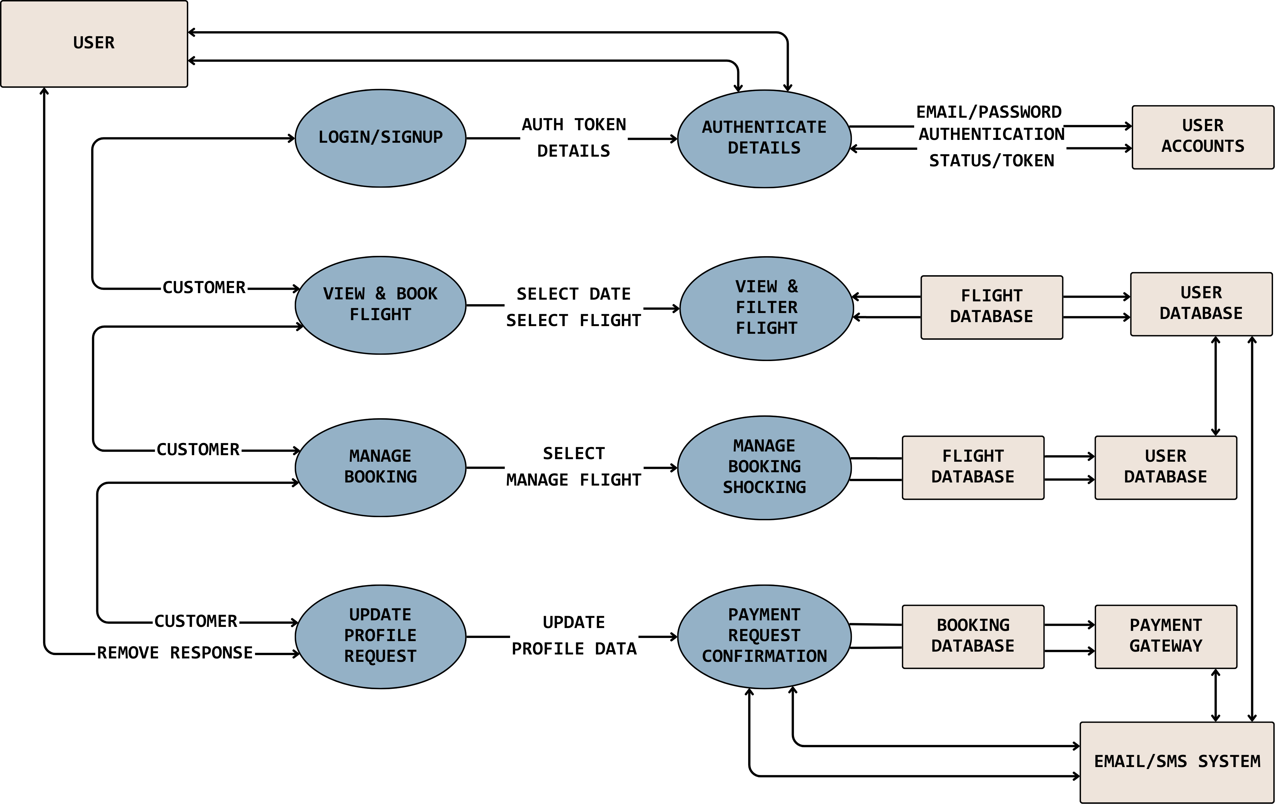
USER DIAGRAM

Slide 11
USER DIAGRAM
Authentication Flow (Signup/Login):
The system ensures secure access via the following steps:
Start: User visits the HOME PAGE.
Choice: User can select SIGN UP or LOG IN.
SIGN UP:
User can enter USERNAME, EMAIL & PASSWORD.
Backend Generates Account and redirects the user to the DASHBOARD.
LOG IN:
User can enter USERNAME, PASSWORD.
Check Email & Password is Correct?
YES: Send OTP to Email for multi-factor authentication, then Redirect to Dashboard.
NO: Show ERROR: INVALID CREDENTIALS.

Slide 12
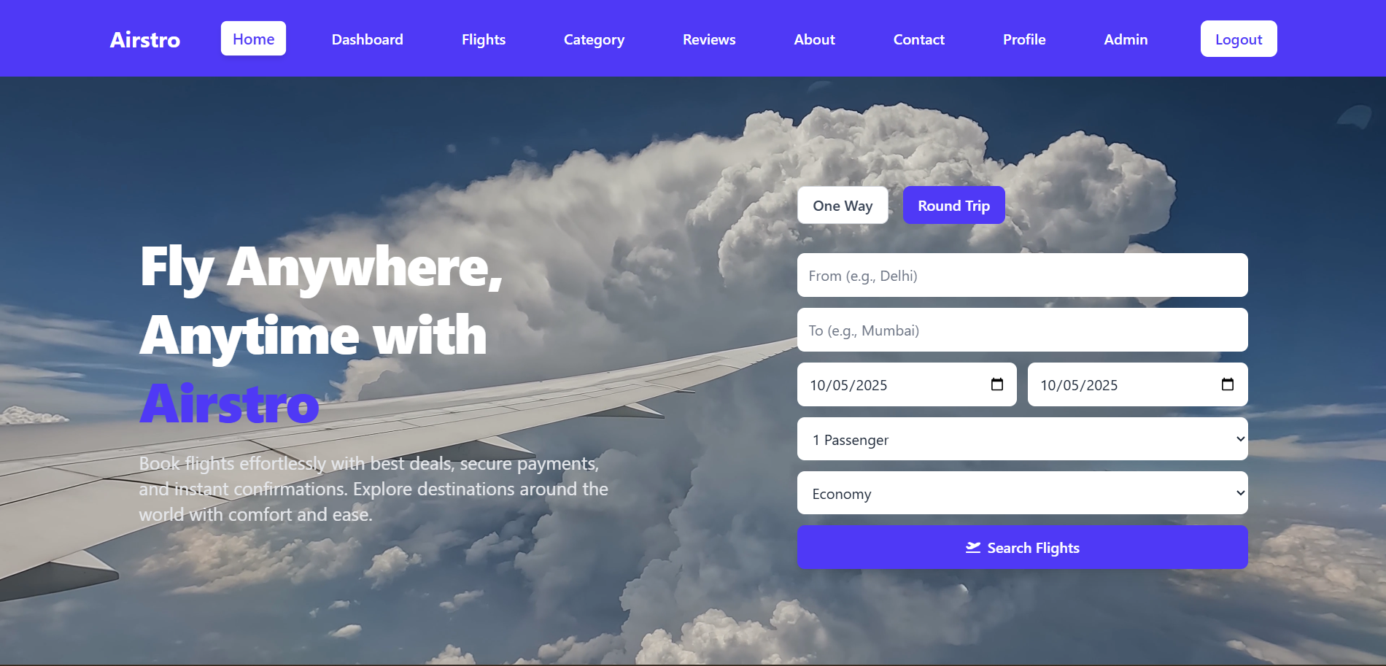
HOME PAGE

Slide 13
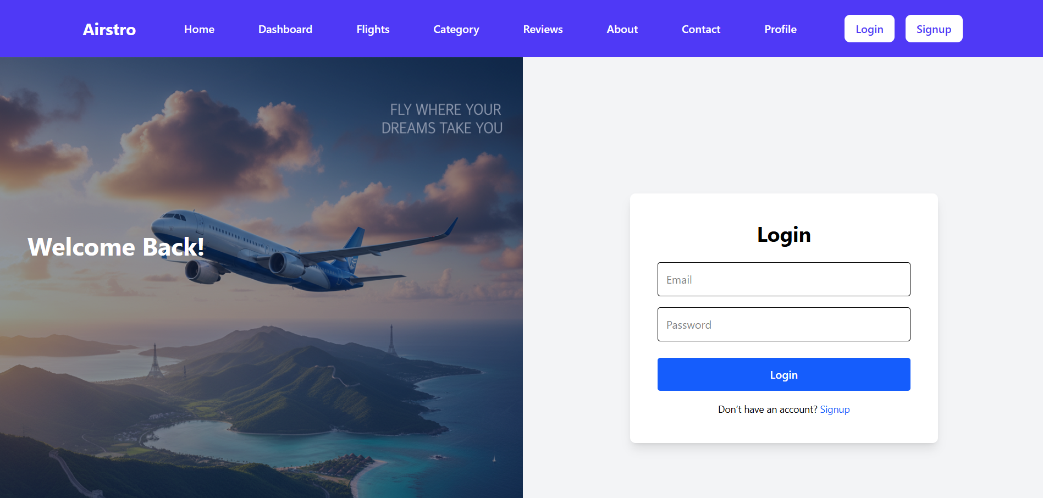
LOGIN/SIGNUP

Slide 14
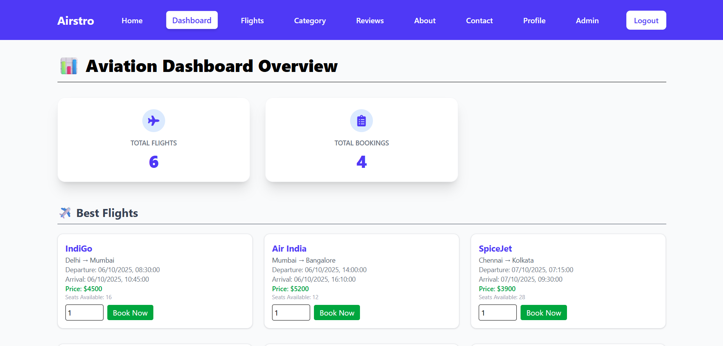
DASHBOARD

Slide 15
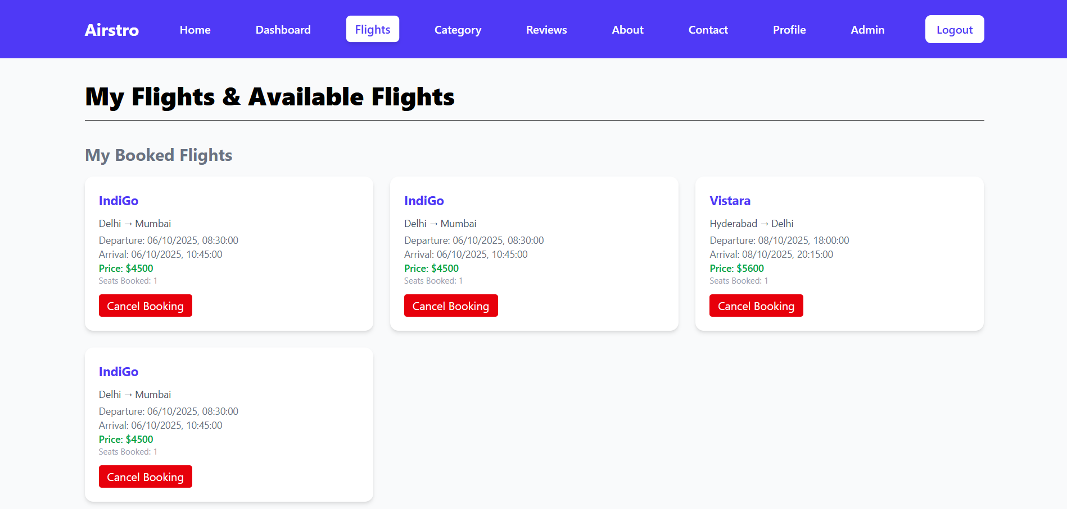
FLIGHTS

Slide 16
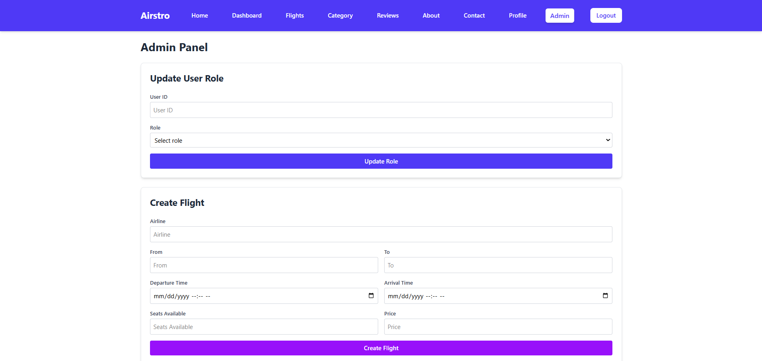
ADMIN

Slide 17
THANK YOU

